Slide 1



Visualising variable importance and variable interaction effects in machine learning models.
Alan Inglis,
Hamilton Institute & Dept. of Mathematics & Statistics,
Maynooth University.
Supervisors: Andrew Parnell, Catherine Hurley
This work was supported by a Science Foundation Ireland Career Development Award grant number: 17/CDA/4695

Slide 2

Introduction
Informative graphics for model visualisations can be overlooked or underused, particularly in the areas of variable importance and variable interactions.
The challenge was to visualise the importance of the variables used to train a machine learning models, such as random forests, support vector machines or neural networks, and the interactions between these variables in a sensible and informative way.
We created a package called vivid (variable importance and variable interaction displays)^{[1]} that contains a suite of plots for displaying joint visualisations for importance and interactions and also the partial dependence.
The aim being to help a researcher to gain a deeper insight into the importance and interactions of variables in a model.

Slide 3
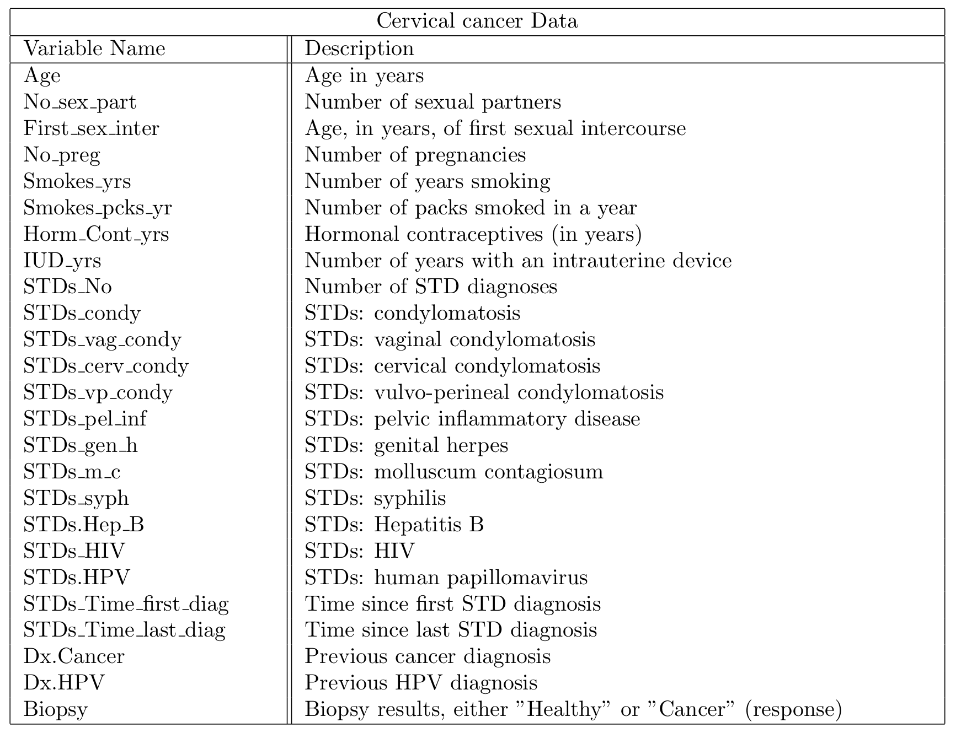
Data
Cervical cancer risk factors^{[2]}.
Comprised of historical medical records & personal information.
Scaled by log(x+1) to account for skewed values.

Slide 4
Traditional Importance and Interaction plots
Figure 1: Variable importance plot produced from randomForest package
Figure 2: Variable interaction plot produced from flashlight package

Slide 5
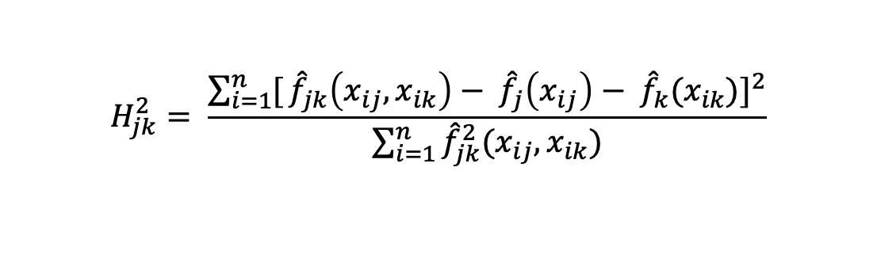
Heatmap displaying importance and interactions jointly
Variable importance on the diagonal. Runs from white (low) to red (high).
Interactions in the upper & lower triangles. Runs from white (low) to dark blue (high).
Either agnostic or embedded importance.
Friedman’s H-statistic^{[3]} is used to measure interactions
$$H_{jk}^{2}= \frac{\sum_{i=1}^{n}{[}{\hat{f}}_{jk}\left(x_{ij},x_{ik}\right)− {\hat{f}}_{j}\left(x_{ij}\right)− {\hat{f}}_{k}(x_{ik})]^{2}}{\sum_{i=1}^{n}{{\hat{f}}_{jk}^{2}(x_{ij},x_{ik})}}$$
Figure 3: Heatmap displaying interactions & importance produced by vivid package
Notes:
We want to combine the traditional plots into something sensible.
Not restricted to one type of importance measure.
We use the dominator only version

Slide 6
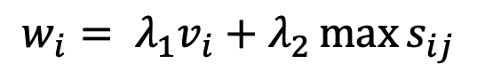
Sorting the Matrix
v_{i} is a measure of variable importance and s_{ij} the interaction measure between variables i and j.
Treat the matrix of interactions as a similarity matrix .
Hierarchical clustering to produce a variable ordering where high-interacting variables are nearby.
We re-order the dendrogram leaves so that the weights w_{i} are generally decreasing.
Leaf sort algorithm^{[4]}.
$$w_{i}= λ_{1}v_{i}+λ_{2}\max{s_{ij}}$$

Slide 7
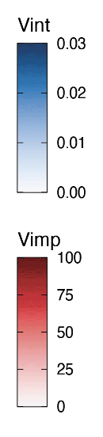
Network Graph
Gives a visual representation of the magnitude of the importance & interaction values.
It achieves this by altering the size of nodes & edges in the graph to represent the range of values.
Node size & colour represent variable importance.
Edge size & colour represent interaction strength.
Allow for clustering.

Slide 8
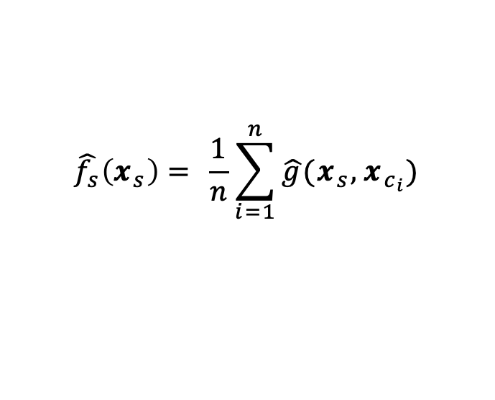
Partial Dependence plots
Define grid along the feature
Make predictions at grid points
Each line per instance is called an ICE (Individual Conditional Expectation) curve
Average of ICE curves is the partial dependence
$$\hat{f_{s}}\left(x_{s}\right)= \frac{1}{n}\sum_{i=1}^{n}{\hat{g}(x_{s},x_{c_{i}})}$$

Slide 9
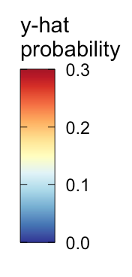
PDPs
Displays the PDPs in a generalised pairs plot style.
2-way partial dependence in the upper triangle.
1-way partial dependence (black line) and ICE-curves (Individual Conditional Expectation curves) on the diagonal.
Scatter-plot in the lower triangle.

Slide 10
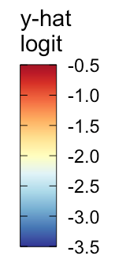
Zen Partial Dependence Plots
Show selected panels of the all-pairs PDP in a space-saving layout.
Zenplots^{[5]} were designed for showing pairwise plots of high-dimensional data in a zigzag layout.
Showing pairs of variables with high interactions.
For a connected graph, a greedy Eulerian path algorithm^{[6]} visits each edge at least once, starting from the highest weighted edge and moving through edges giving preference to the highest weight available edge.

Slide 11
Summary
Novel approach to visualizing importance, interactions and partial dependence.
When compared to traditional visualisations, our approach allows us to evaluate the VIVI in a more efficient manor than would traditionally be possible.
Enhance interpretation even in situations where the number of variables is large and the interaction structure complex.
The H-statistic is computationally slow, future work may involve trying to optimize the H-statistic algorithm
Adding more compatibility for more models.

Slide 12
References
[1]: Alan Inglis, Andrew Parnell & Catherine Hurley (2020) vivid. https://CRAN.R-project.org/package=vivid.
[2]: K. Fernandes, J. S. Cardoso, and J. Fernandes. Transfer learning with partial observability applied to cervical cancer screening. In Iberian conference on pattern recognition and image analysis, pages 243–250. Springer, 2017
[3]: J. Friedman and B. Popescu. Predictive learning via rule ensemble. The Annals of Applied Statistics,, pages 916–954, 2008.
[4]: D. Earle and C. Hurley. Advances in dendrogram seriation for application to visualization. Journal of Computational and Graphical Statistics, 24, 03 2015. doi: 10.1080/10618600. 2013.874295.
[5]: M. Hofert and W. Oldford. Zigzag expanded navigation plots in R: The R package zenplots. Journal of Statistical Software, 95(4):1–44, 2020. doi: 10.18637/jss.v095.i04.
[6]: C. Hurley and R. Oldford. Eulerian tour algorithms for data visualization and the pairviz package. Computational Statistics, 26(4):613–633, 2011. URL https://EconPapers. repec.org/RePEc:spr:compst:v:26:y:2011:i:4:p:613-633.

